Slide 1
Electronic Cash Register (ECR) & Terminal Flow
1

Slide 2
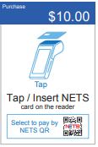
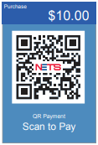
Payment Flow for NETS QR on ECR/POS
1
POS/ECR
ROADMAP TERMINAL
Meat Item $5.00
Drink Item $1.50
Coffee Can $2.00
Snacks $0.50
$10.00
7
8
9
4
5
6
1
2
3
0
0
C
Sub Total $9.00
GST $1.00
TOTAL $10.00
NETS
OTHER
NETS QR
CASH
2
POS/ECR
ROADMAP TERMINAL
Meat Item $5.00
Drink Item $1.50
Coffee Can $2.00
Snacks $0.50
$10.00
7
8
9
4
5
6
1
2
3
0
0
C
Sub Total $9.00
GST $1.00
TOTAL $10.00
NETS
OTHER
NETS QR
CASH
Notes:
Today, some ECR have NETS button, some ECR have both NETS & NETS QR button.

Slide 3



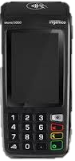
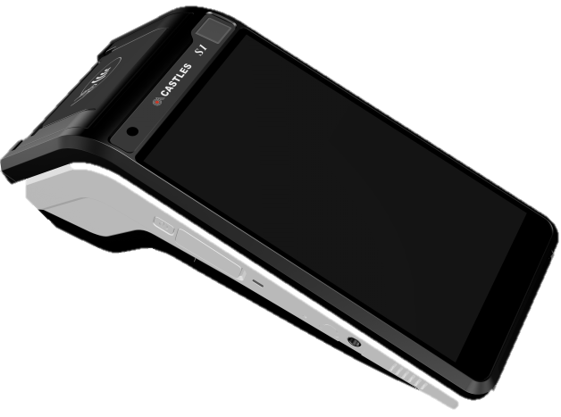
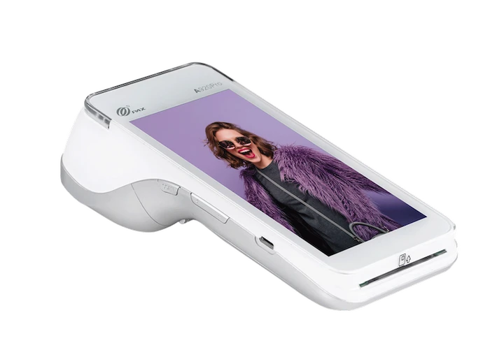
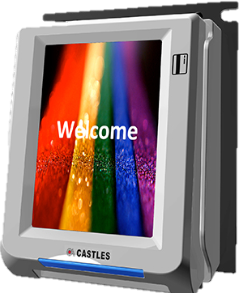
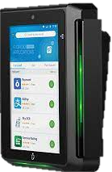
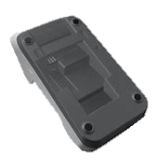
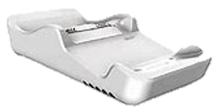




NETS Terminal
1
2
3
Desktop
Ingenico DESK5000
Standalone countertop with added printer
Mobile
Ingenico MOVE5000
Go-to portable, durable and with printing power.
Mobile / Desktop
Castle S1000F
Go-to portable, large screen, and mobile all-in-one android device
Unattended / Kiosk
Castle UPT1000F
Self-service and contactless for quick tap and pay.
Mobile / Desktop
PAX 920pro
Portable, with printer and all-in-one android device with stable connections through cradle.
Unattended / Kiosk
PAX IM30
Self-service, large screen and all-in-one android device for quick tap and pay.
NETS Confidential
Notes:
Keep hidden

